Slide 1
Sudden Sensorineural Hearing Loss
Dr. Dinesh Kumar Sharma
Assistant Professor, Department of ENT, GMC Amritsar

Slide 2
Overview
Definition
Etiopathogenesis
Management
Clinical Features
Diagnosis

Slide 3
Introduction
Devastating to patients
Frustrating for physicians
Definitive diagnosis & treatment still unknown
First described by Dr. De Kleyn 1944

Slide 4
Definition
According to National Institute on Deafness and other communication disorder (NIDCD) criteria defined as:
Subjective sensation of hearing impairment in one or both ears developing within 72 hours and a decrease in hearing of more than or equal to 30 decibels (dB), on 3 consecutive frequency in comparison to normal ear on audiometry

Slide 5
Statistics
15000 cases reported per year worldwide
4000 cases per year in US
Limited Indian data available

Slide 6
Statistics
Estimated annual incidence of SSNHL is 5 to 30 cases per 100,000 population
Actual incidence may be higher since many patients recover spontaneously

Slide 7
Statistics
Highest incidence in 50-60 yrs. old
Lowest incidence in 20-30 yrs. old
M=W
A specific cause in about 10% of patients
Less than 5% bilateral

Slide 8
Statistics
Tinnitus occurs in about 80% of patients
Vertigo, indicating an associated peripheral vestibular dysfunction, in about 30%.
Up to 80% of patients report a feeling of ear fullness.

Slide 9
Statistics
Onset occurs in < 72 hours
Recovery rate without treatment 32% to 79%
Usually within two weeks of onset
Only 36% patients have complete recovery

Slide 10
ETIOLOGY
Viral and infectious
Autoimmune
Vascular
Labyrinthine membrane rupture
Neoplastic
Neurologic

Slide 11
Etiology: Viral & infectious
Meningococcal meningitis
Herpesvirus (simplex, zoster, varicella, cytomegalovirus)
Mumps
Human immunodeficiency virus
Mycoplasma
Cryptococcal meningitis
Toxoplasmosis
Syphilis
Rubella

Slide 12
Etiology: Autoimmune
Autoimmune inner ear disease
Ulcerative colitis
Relapsing polychondritis
Lupus erythematosus
Polyarteritis nodosa
Cogan’s syndrome
Wegener’s granulomatosis

Slide 13
Etiology: traumatic
Perilymph fistula
Inner ear decompression sickness
Temporal bone fracture
Inner ear concussion
Otologic surgery (stapedectomy)
Surgical complication of non-otologic surgery

Slide 14
Etiology: Vascular
Vascular disease/alteration of microcirculation
Vertebrobasilar insufficiency
Red blood cell deformability
Sickle cell disease
Cardiopulmonary bypass

Slide 15
Etiology: Vascular
Some evidence suggests that SSNHL loss is associated with both acute and increased long-term risk of stroke.
In a prospective series of 364 patients with acute stroke in the posterior circulation, hearing loss occurred in 8%, sometimes preceding the stroke by several days.
Occlusion of the anterior inferior cerebellar artery is associated with vertigo, nystagmus, facial weakness, and gait ataxia in addition to SSNHL

Slide 16
Etiology: Neoplastic
Acoustic neuroma
Leukemia
Myeloma
Metastasis to internal auditory canal
Meningeal carcinomatosis
Contralateral deafness after acoustic neuroma surgery

Slide 17
ETIOLOGY: Drugs
There are case reports of sudden sensorineural hearing loss associated with:
Penicillin
Oestrogens
Phosphodiesterase-5 inhibitors
Pegylated interferon
Ribavirin
Aminoglycosides
Chemotherapeutic agents

Slide 18
History and Physical
Sudden sensorineural hearing loss is considered to be a true otologic emergency, given the observation that there is less recovery of hearing when treatment is delayed.
The primary goal is to rule out any treatable causes.

Slide 19
History and Physical
Diagnostic evaluation of the patient with sudden hearing loss begins with a thorough history and physical exam.
Details of the circumstances surrounding the hearing loss and the time course of its onset should be elicited.

Slide 20
History and Physical
Associated symptoms, such as tinnitus, vertigo or dizziness, and aural fullness should also be asked about.
Clinical experience has shown that about one-third of patients note their hearing loss upon first awakening in the morning
About one- half the cases will have associated vertigo

Slide 21
History and Physical
Patients should also be questioned about previous otologic surgery, ototoxic drug use, and previous or concurrent viral or upper respiratory tract infections.
Any history of trauma, straining, diving, flying, and intense noise exposure should be noted.

Slide 22
History and Physical
Any history of trauma, straining, diving, flying, and intense noise exposure should be noted.
Past medical history of other diseases associated with sudden hearing loss should also be obtained such as diabetes, autoimmune disorders, malignancies, neurologic conditions (multiple sclerosis), and hypercoagulable states.

Slide 23
History and Physical
A complete head and neck exam should be performed on all patients with sudden hearing loss.
More often than not, the exam will be unremarkable, however, any processes such as middle ear effusions, infections, cholesteatoma, and cerumen impaction should be excluded.
A thorough neurological exam including Weber and Rinne, cerebellar and vestibular testing should be performed.

Slide 24
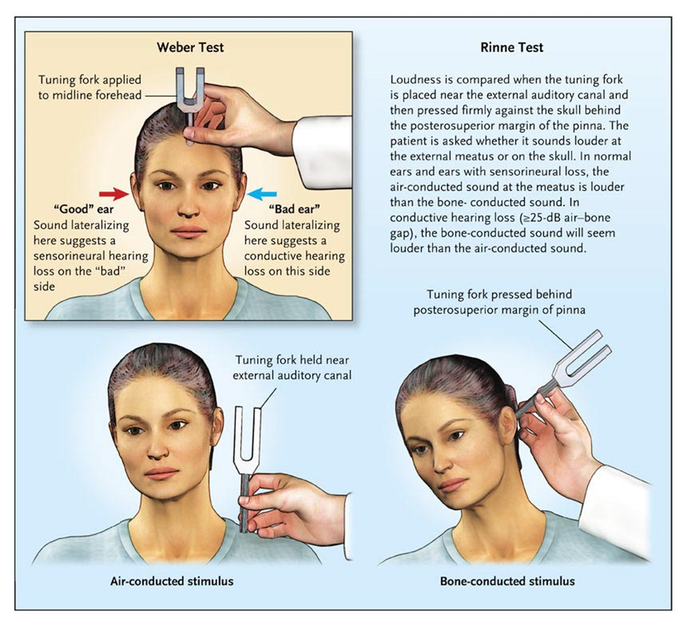

Slide 25
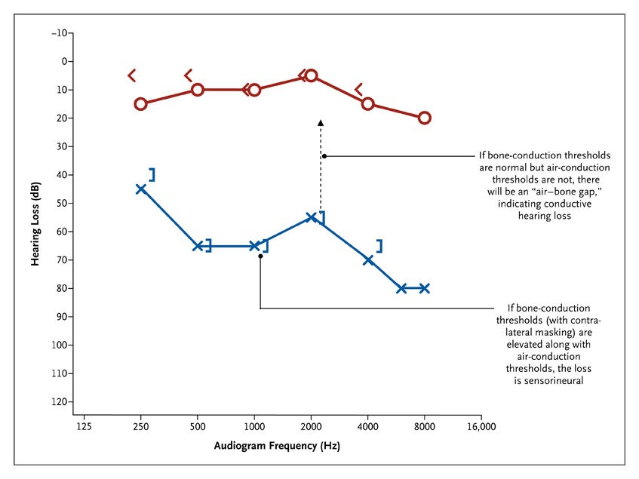
Standard Audiogram, Showing Sensorineural Hearing Loss in the Left Ear
Rauch S. N Engl J Med 2008;359:833-840

Slide 26
Patients with confirmed sudden sensorineural hearing loss should undergo a neuro-otological examination to establish the presence or absence of concomitant peripheral or central vestibular dysfunction.
Cardiovascular examination should exclude atrial fibrillation, aortic and mitral murmurs, and carotid bruits.

Slide 27
Known treatable causes of SSNHL

Slide 28
Autoimmune
Autoimmune hearing loss may be associated with or part of systemic autoimmune diseases such as:
Cogan's syndrome
Wegener’s granulomatosis
Polyarteritis nodosa
Temporal arteritis,
Systemic lupus erythomatosis
Primary to the inner ear.

Slide 29
Autoimmune
The pathogenesis of immune-mediated sensorineural deafness and vestibular dysfunction are unclear, but are presumed to include: vasculitis of vessels supplying the inner ear, autoantibodies directed against inner ear antigenic epitopes, or cross-reacting antibodies.
Autoimmune hearing loss implies that inner ear proteins are recognized immunologically as foreign or non-self

Slide 30
Autoimmune: Cogan’s Syndrome
An autoimmune disease of the cornea and vestibulo-auditory apparatus.
It occurs primarily in young adults
Typically presents with interstitial keratitis) and Meniere's-like attacks of vertigo, ataxia, tinnitus, nausea, vomiting, and hearing loss which develop within several months of each other.
The cause is unknown

Slide 31
Autoimmune: Cogan’s Syndrome
The cornerstone of therapy is corticosteroids: topical for IK and oral for vestibulo-auditory involvement.
Most authors suggest using prednisone 1mg/kg for 2-4 weeks with a subsequent rapid taper for cases of complete resolution and slow taper for those with incomplete response.

Slide 32
Traumatic
Traumatic breaks in the membranous labyrinth are accepted causes of sudden hearing loss.
Cochlear membrane breaks may be either intra-cochlear, as is thought to occur in Meniere’s disease, or involve the labyrinthine oval and/or round windows with a resultant perilymph fistula.

Slide 33
Traumatic
The patients history will usually elicit an inciting event such as a blow to the head, sneezing, bending over, lifting a heavy object, exposure to sudden changes in barometric pressure (such as during flying or diving), or exposure to a loud noise.

Slide 34
Traumatic
Initial treatment should include 5 days of strict bed rest with the head of bed elevated thirty degrees.
The patient should avoid straining or hard nose blowing.
Stool softeners may be given.
If the patient has improvement, 6 more weeks of modified physical activity should be followed.
If no improvement is seen after five days, surgical therapy including middle ear exploration with patching of the perilymphatic fistula should be performed.

Slide 35
Neoplastic
Acoustic neuromas are usually associated with gradually progressive hearing loss.
However, the increasingly widespread use of CT and MRI imaging of patients has indicated that nearly 10% to 19% of patients with acoustic tumors may present with SHL

Slide 36
Idiopathic Sudden Sensorineural Hearing loss
Etiologic Theories

Slide 37
Etiologic Theories: viral
Current belief is that viral cochleitis is the culprit in the majority of cases of ISSNHL
The exact mechanism by which viruses cause hearing loss has not been definitively proven.
However, studies suggest that there is a significant contribution of the host immune response to the pathologic changes in the membranous labyrinth and subsequent hearing loss of patients with ISSNHL

Slide 38
Etiologic Theories: viral
In addition, several studies in humans have shown beneficial effects of steroids on recovery from ISSNHL.
Since the primary effect of steroids is anti-inflammatory, this lends additional support to host immune mediated cochleitis in response to a virus.

Slide 39
Etiologic Theories: autoimmune
McCabe first described autoimmune inner ear disease (AIED) in 1979.
The clinical picture of AIED usually consists of rapidly progressive bilateral sensorineural hearing loss usually in the absence of other systemic manifestations.
Approximately 50% of patients will complain of dizziness.
The symptoms often progress over weeks or months but can also present as sudden hearing loss

Slide 40
Etiologic Theories: autoimmune
Most patients present with bilateral disease, and when dizziness is present, vestibular testing usually reveals bilateral reduced response.
AIED has a slight predominance in middle-aged females, but can occur in both sexes and can begin in childhood.

Slide 41
Etiologic Theories: autoimmune
Treatment for AIED is controversial
The general consensus is that steroids are effective and should be used.
Most sources recommend prednisone 1mg/kg/day for 4 weeks followed by a slow taper if the patient responds.
If the patient relapses on the taper, high dose prednisone and if continued recurrence occurs with tapering, a cytotoxic agent such as methotrexate (MTX) at a dosage of 7.5-15 mg weekly with folic acid, or cyclophosphamide (Cytoxan) should be instituted.

Slide 43
The inner ear is supplied by the internal auditory artery
Within the IAC, the internal auditory artery divides into two main branches.
The common cochlear and anterior vestibular arteries
Division of the vestibulocochlear artery results in the posterior vestibular artery and the cochlear ramus

Slide 44
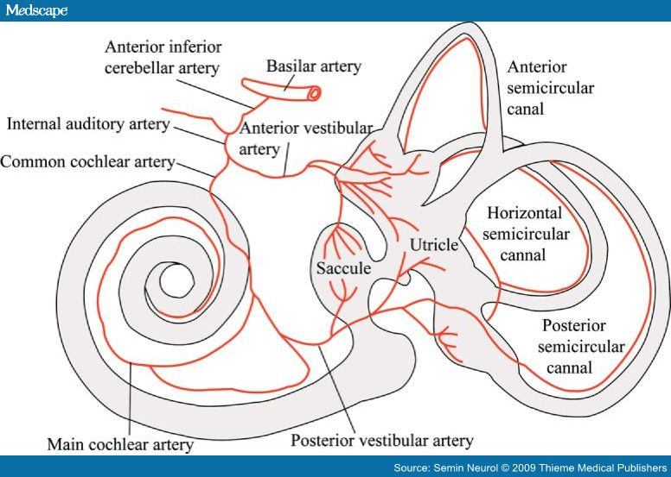

Slide 45
Etiologic Theories: Vascular
The arterial supply to the cochlea is such that the basal turn is fed first by the main cochlear artery with the cochlear apex fed last.
Based on this anatomy one would expect occlusion of the labyrinthine artery to cause both vestibular and auditory symptoms which is supported by histopathologic findings as describe above.
In addition, one would expect temporary occlusion in blood flow to affect low frequency areas of the cochlea first as these areas are the most distal in terms of blood supply.

Slide 46
Etiologic Theories: Vascular
Cochleovestibular blood supply may be affected by circulatory disorders such as embolic phenomenon, thrombosis, vasospasm, and hypercoagulable or high viscosity states resulting in SSNHL
The underlying pathophysiology can be explained by the occurrence of sudden anoxic injury to the cochlea.
The cochlea is extraordinarily intolerant of blood supply disruptions.
Suga and co-workers performed experimental embolizations of cochlear vessels and showed loss of cochlear action potentials within 60 seconds.

Slide 47
prognosis

Slide 48
Prognosis
Published series report spontaneous recovery rates for patients with SHL range from 47% to 63%.
Patients in whom there is no change within 2 weeks are unlikely to show much recovery.
Four variables have been shown to affect recovery from ISSNHL
Time since onset
Audiogram type
Vertigo
Age

Slide 49
Prognosis: time since onset
Sooner the patient is seen and therapy initiated, the better the recovery.

Slide 50
Prognosis: Age
Those under 15years and over 60 years have significantly poorer recovery rates.

Slide 51
Prognosis: Vertigo
Patients with severe vertigo have significantly worse outcomes than patients with no symptoms of vertigo.

Slide 52
Prognosis: Audiogram
Patients with profound hearing loss significantly decreased recovery rates.
Patients with mid frequency hearing loss, particularly when hearing at 4000kHz was worse than 8000kHz, have an excellent prognosis.

Slide 53
Treatment of issnhl

Slide 54
Combined therapy
Vasodilators
Diuretics
Plasma Expanders
Contrast Dyes
Vitamins
Corticosteroids

Slide 55
Bed Rest
Stool Softeners
Stress
Alcohol
Elevate Head
Noise exposure

Slide 56
vasodilators
The use of vasodilators is based on the premise that it promotes blood flow and eliminates vasospasm.
Drugs in this class include 5%CO2 (in the form of Carbogen), atropine, histamine, procaine hydrochloride, and papaverine hydrochloride.
The fact that no study has provided conclusive evidence of their benefit and their potential side effects has limited their use.

Slide 57
Vasodilators: carbogen
Carbogen, which is a combination of 95% oxygen and 5% carbon dioxide has been used, and is still used by some physicians in patients in whom a vascular etiology is suspected for their hearing loss.
Studies have shown that carbogen increases the partial pressure of oxygen in perilymph.
In addition carbon dioxide is a known potent vasodilator of the vestibulocochlear vasculature, resulting in increased blood flow.

Slide 58
Diuretics
Diuretics have been proposed for treatment of sudden SNHL because this disorder has been associated with endolymphatic hydrops, and some believe that it may be due to labyrinthine edema.
No data clearly support their usage and some diuretics are ototoxic.

Slide 59
anticoagulants
The use of anticoagulants, such as heparin and warfarin, is based on the idea of decreasing "blood sludge" in the vessels supplying the organs of hearing.
Their use is limited by potential side effects.
Plasma expanders such as low molecular weight dextran also work on the concept of decreasing "blood sludge," by reducing blood viscosity and platelet aggregation. However, its use is potentially fatal.

Slide 60
Surgery
Exploration of the middle ear with repair of an inner ear fistula is recommended in patients with a clear history of sudden hearing loss associated with diving, straining, altitude change, or recent otologic surgery.
The role of surgery in patients who do not improve with non-surgical therapy remains controversial.

Slide 61
ORAL corticosteroids
Oral corticosteroids are widely used, although the supporting evidence is weak.
Possible modes of action:
Suppression of an immune response
Changes in microvascular circulation
Mineralocorticoid effects
A decrease in endolymphatic pressure

Slide 62
ORAL corticosteroids
Although supporting data are limited, corticosteroid therapy (usually a 2-week burst and taper of oral prednisone, starting at 60 mg per day, or equivalent doses of methylprednisolone) is the current standard of care, according to a randomized trial suggesting that it may improve or restore hearing and because of the absence of other known effective therapies.

Slide 63
corticosteroids
Intratympanic injections of corticosteroids may be an alternative, particularly for patients who have or are at high risk of complications from oral therapy, although evidence to support this strategy is even more limited.

Slide 64
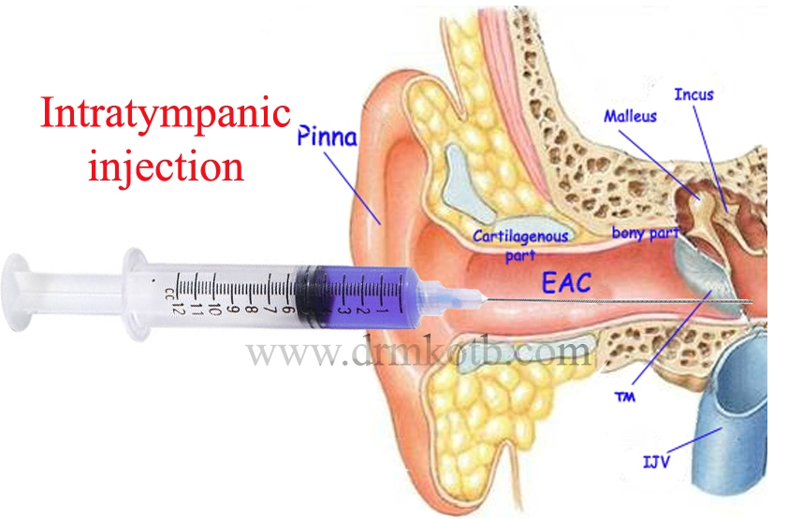

Slide 65
antivirals
Antivirals have recently come into favour in the treatment of ISSNHL
Animal models of viral labyrinthitis treated with prednisone and acyclovir combined have shown significantly higher rates of hearing recovery compared to either drug alone.
This combination therapy has already proven its effectiveness in Ramsay Hunt syndrome and herpes zoster oticus and has also been proposed for the treatment of Bell's palsy.
Studies are now on-going to look at the efficacy of acyclovir in the treatment of patients with ISSNHL.

Slide 66
Case Vignette
A healthy 58-year-old woman answers the telephone and realizes that her hearing is diminished on the left side.
She notices aural fullness and loud tinnitus in the affected ear.
Later that day she has several hours of mild vertigo that clears by the following morning. A healthy 58-year-old woman answers the telephone and realizes that her hearing is diminished on the left side.
She notices aural fullness and loud tinnitus in the affected ear.
Later that day she has several hours of mild vertigo that clears by the following morning.
Over the next few days, repeated self-administered ear cleaning with the use of an over-the-counter kit does not relieve the symptoms.
How should she be evaluated and treated

Slide 67
Recommendations
Patients such as the woman described in the vignette, who present with unilateral ear blockage or fullness, should promptly be evaluated for possible sudden sensorineural hearing loss.
Sudden sensorineural hearing loss is considered by otologists to be a true otologic emergency, given the observation that there is less recovery of hearing when treatment is delayed.
Hearing loss can be assessed over the telephone (e.g., by asking the patient to move the phone from ear to ear for comparison).
If hearing is reduced, the patient should be asked to hum and to report on which side the sound is louder; although the test is imperfect, sound usually localizes toward a conductive loss and away from a sensorineural loss.

Slide 68
An office evaluation and complete audiogram is indicated if there is any suspicion of sensorineural hearing loss.
If an audiogram reveals unilateral sensorineural hearing loss, then an MRI with gadolinium is needed to rule out a retrocochlear abnormality, such as demyelinating disease, neoplasm, or stroke.
In the absence of these findings, sudden sensorineural hearing loss is the presumed diagnosis.
Treatment should not be delayed, even if imaging cannot be obtained promptly

Slide 69
Patients reports unilateral ear blockage-new onset, developing over<72 hours
NO
No Emergency
Yes
Hum Test
Probable conductive hearing loss
Sound lateralizes to bad ear
Sound lateralizes to better ear
Probable SNHL- a true otologic emergency
Audiometric confirmation of SNHL
False Alarm
No
Normal
Start Prednisolone Blast and taper
MRI
Abnormal
Repeat audiometry in follow-up
Neurology Consultation

Slide 70
summary
SSNHL is subjective sensation of hearing impairment in one or both ears developing within 72 hours and a decrease in hearing of more than or equal to 30 decibels (dB), on 3 consecutive frequency in comparison to normal ear on audiometry
Most patients with SSNHL cannot be given a cause for their diagnosis.
Highest incidence in 50-60 yrs. old

Slide 71
Recovery rate without treatment 32% to 79%
Recovery usually begins within two weeks of onset
SSNHL is considered to be a true otologic emergency, given the observation that there is less recovery of hearing when treatment is delayed.
Corticosteroid therapy (usually a 2-week burst and taper of oral prednisone, starting at 60 mg per day, or equivalent doses of methylprednisolone) is the current standard of care
Intratympanic injections of corticosteroids may be an alternative, particularly for patients who have or are at high risk of complications from oral therapy

Slide 72
THANKYOU!

